Slide 1
BidStamp Vendor Information System Webinar
Information and Overview

Slide 2
Presenter
Kelly Parker, Director, Cooperative Contracts
Chief Procurement Office
Organizers
Joan Scott, Assistant Director, Cooperative Contracts
Chief Procurement Office

Slide 3
Housekeeping
Available for Download:
DIR BidStamp Training Guide: Vendor Information System Portal (Vendor Guide)
Power Point Presentation
Also available on DIR’s Website: Information for Vendors

Slide 4
Agenda
What is the BidStamp?
Vendor Information System Portal (VIS) defined
Account creation and login
Vendor account management
Responding to a solicitation
Demonstration
Questions

Slide 5
BidStamp Defined
The BidStamp application is DIR’s e-procurement system that supports solicitations and contracts throughout the procurement lifecycle. It facilitates and adds automation to the following procurement processes:
Solicitation creation and posting
Collecting vendor responses
Evaluation of responses and recommendation
Contract creation, award, and management

Slide 6
BidStamp VIS Portal
Vendor Information System Portal (VIS) provides vendors with the ability to create a profile that supports responding to DIR solicitations. This presentation introduces Vendors to 3 major components of the BidStamp VIS portal:
Account creation and login
Vendor account management
Responding to a solicitation

Slide 7
Navigating to the VIS portal
Navigating to the VIS portal log on page:
https://dircommunity.force.com/BidStamp/
OR
(reference Vendor Guide Section 2.1 Home Page Navigation):

Slide 8
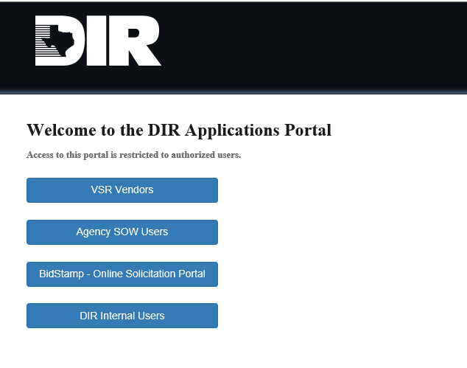
Navigating to the VIS portal, cont.

Slide 9
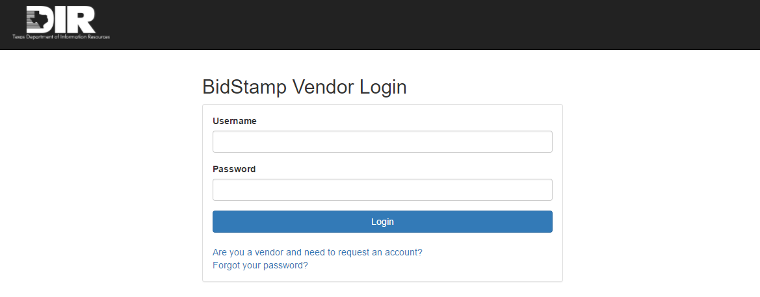
Account creation and login
(reference Vendor Guide Section 2.1 Home Page Navigation):
Navigating to the VIS portal log on page:
https://dircommunity.force.com/BidStamp/
To request an account select the link “Are you a vendor and need to request an account?”

Slide 10
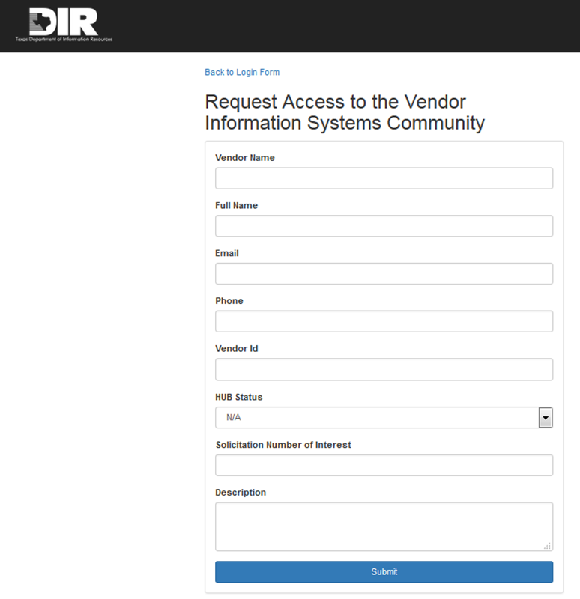
VIS Account Request
(reference Vendor Guide Section 3 Account Creation):
Complete the request form, all fields are required, and select “Submit”.
The form will navigate to a confirmation message verifying the request was submitted.
DIR will review and enable Vendor BidStamp account.
Once enabled, the user who submitted the request will receive a confirmation email with a link to create a password. This will officially give Vendor access to the BidStamp VIS Portal.
Company Name
Contact Name: First, Last
Texas ID # (TIN) or Federal Employer # (EIN)
DIR-TSO-TMP-###
Solicitation Name

Slide 11
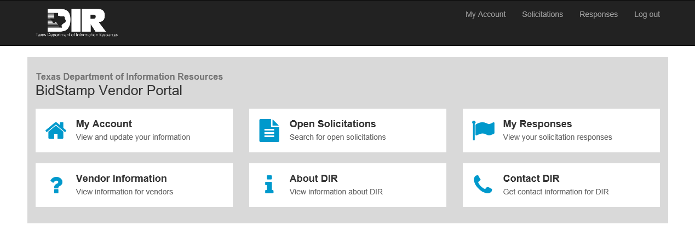
BidStamp VIS Home Page
After entering your login credentials, you will be navigated to the VIS Home Page.
(reference Vendor Guide Section 2 Account Creation):
PLEASE NOTE: Solicitations posted on DIR’s BidStamp VIS are provided as a courtesy and convenience. DIR does not commit to the availability of any document there for any period of time. THEREFORE: Vendors must refer to listings on the state’s Electronic State Business Daily for the official documentation of any solicitation; and Vendors are required to maintain their own records

Slide 12
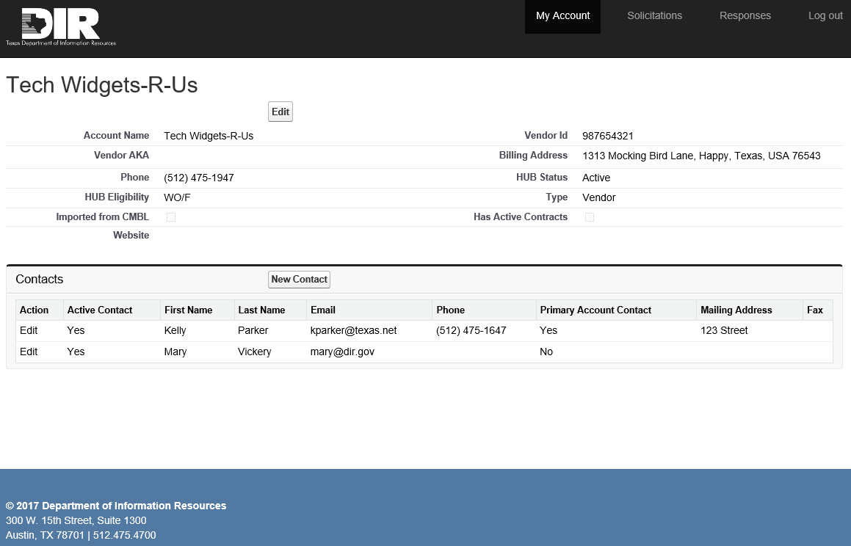
Vendor Account Management
Non-CMBL vendor accounts will be editable by the primary contact.
By Clicking “Edit”, the primary contact can then make updates to any of the fields that are editable. Certain fields are read-only.
Selecting the “Save” button (visible when changes are made) will save any changes the primary contact made.
(reference Vendor Guide Section 4 Vendor Account Management):

Slide 13
Vendor Account Management, cont.
Two types of contacts can be associated with BidStamp VIS portal accounts: standard contacts and primary contacts.
Primary Contacts – The main contacts for a given account. By default, the first contact to request an account will receive primary contact status.
If the vendor account information is not imported from a CMBL vendor profile, the primary contact(s) associated with an account can edit overall vendor account information in addition to their own contact information.
The primary contact will have the ability to edit the contact information of other contacts associated with the account.
Primary contacts can submit questions and response materials on behalf of the account.
Standard Contacts – The secondary contacts for a given account. Standard contacts must request primary accounts status from the accounts primary contact.
Standard contacts are only able to edit the information associated with their own account.
Standard contacts can submit questions and response materials on behalf of the account.

Slide 14
Vendor Account Management, cont.
Primary contacts can add New Contacts and edit all contacts.
By Clicking New Contact, the primary contact can enter contact information into editable fields.
By clicking “Edit”, the primary contact can then make updates to any of the fields that are editable. Certain fields are read-only.
Selecting the “Save” button (visible when changes are made) will save any changes the primary contact made.
(reference Vendor Guide Section 4.1.2 Create/Update Contacts):

Slide 15
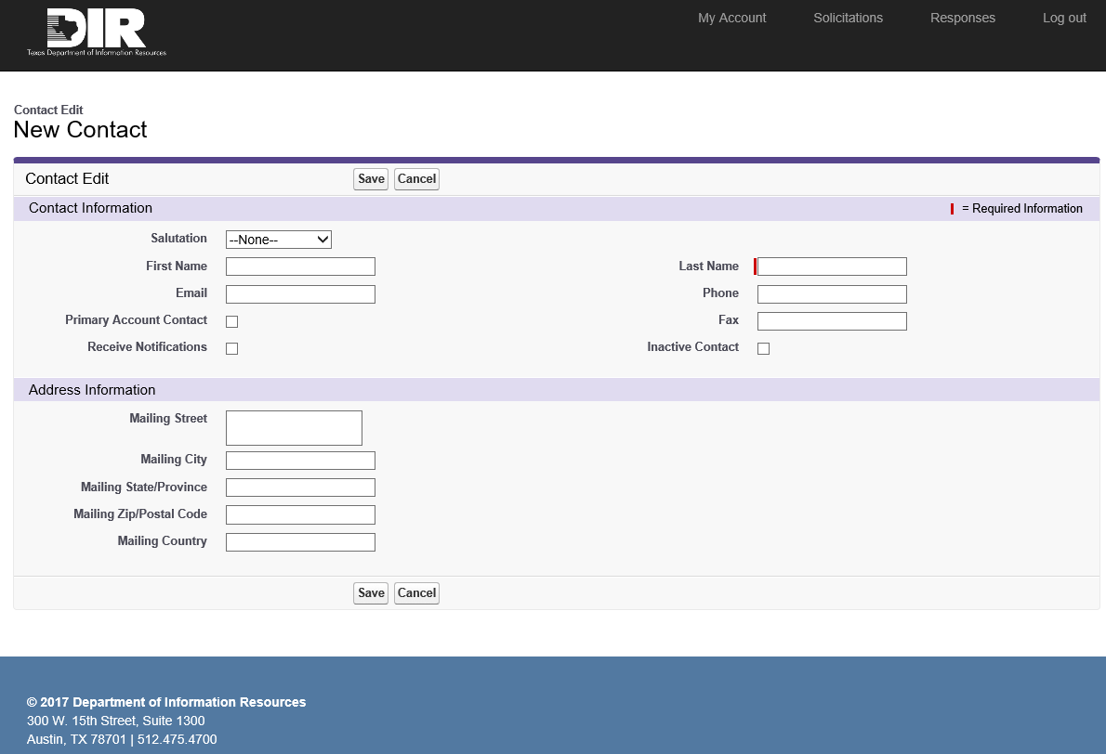
Vendor Account Management, cont.
“Primary Account Contact” will assign the new contact as an additional primary contact.
“Receive Notifications” checkbox will enable a contact to receive notifications for any solicitation the contact subscribes to.
Selecting the “Save” button will save any changes the primary contact made.

Slide 16
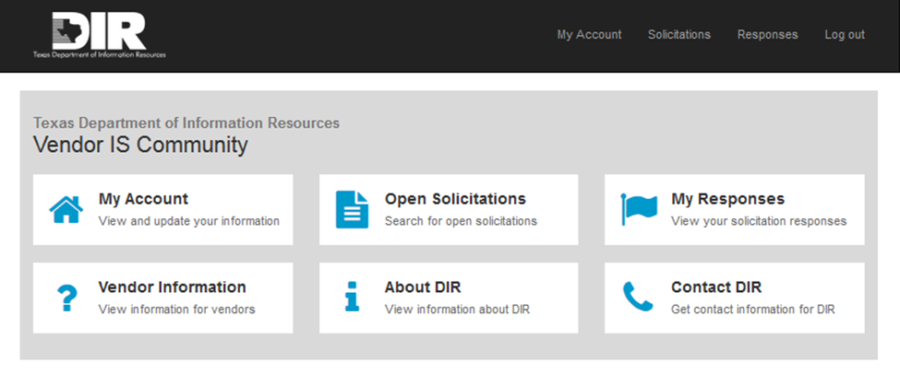
Responding to a Solicitation
After Vendor account is enabled, Vendor can submit and manage RFO responses from the BidStamp VIS portal.
(reference Vendor Guide Section 5.0 Vendor Response Management):

Slide 17
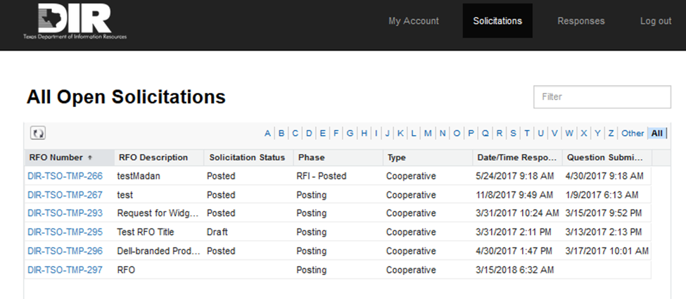
Creating a New Response
To create a new response:
Log in to the VIS portal and select the “Open Solicitations” tile
Click on the “RFO Number” of the solicitation you want to respond to
You will be navigated to the “RFO Number” detail page

Slide 18
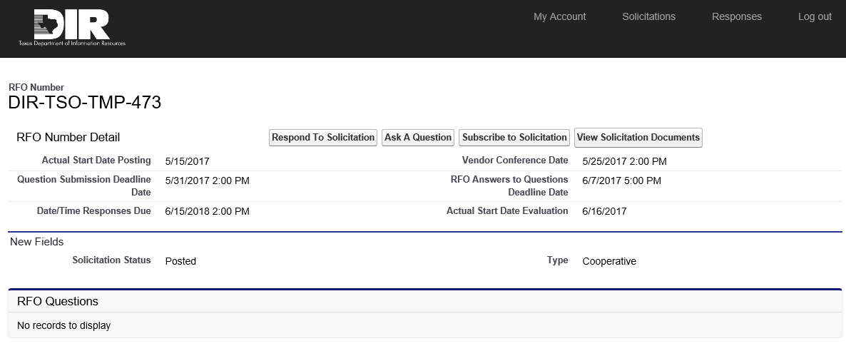
Creating a New Response, cont.
This page will display important deadlines for the solicitation and list any questions Vendor has submitted.
Buttons discussed on the next slide.

Slide 19
Creating a New Response, cont.
RFO Number Detail Page Button Description:
Respond to a Solicitation (or View Response): Create a new response or view a response that is in-progress. If a response has already been created or started, this button will read as “View Response” and allow you to resume your progress on an existing RFO response.
Ask A Question: Submit a question to be reviewed by a DIR resource. Questions can be submitted up until the “Question Submission Deadline date” indicated in the RFO document and on the detail page.
Subscribe to Solicitation: Subscribe to a solicitation if you would like to receive addendum notifications. To subscribe to the solicitation, you must select the “Subscribe to Solicitation” button AND have enabled your contact to “Receive Notifications”. (reference slide 15 of this presentation)
View Solicitation Documents: Navigate to the ESBD posting for a solicitation and view the solicitation’s documents.

Slide 20
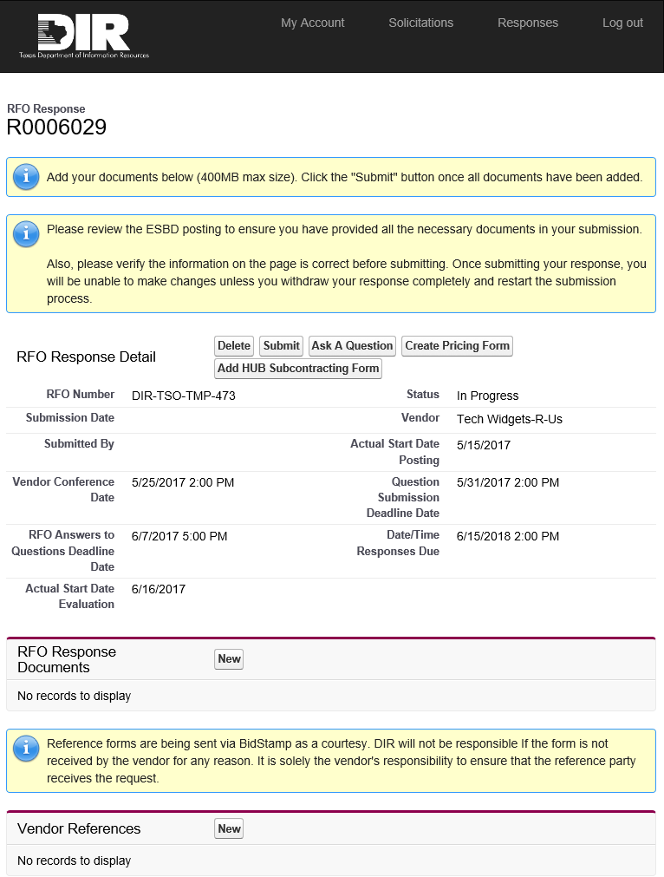
Respond to a Solicitation
“RFO Response Page” buttons:
Delete: Delete all information that has been uploaded and the response record before the response has been submitted. Note: Once the response is submitted, Vendor must use the Withdraw button to make any changes. Withdraw button will appear upon solicitation submission.
Submit: Submits the response record and all associated information. (reference Vendor Guide Section 5.7)
Ask A Question: Questions can be submitted up until the “Question Submission Deadline date” indicated in the RFO document and on the detail page. (reference Vendor Guide Section 5.6)
Add (or Edit) HUB Subcontracting Form: Complete an automated version of the HSP form. Note: Vendors must also print, sign, and upload the signed HSP. (reference Vendor Guide Section 5.4)
Create Pricing Form: Create a pricing form to submit pricing information for your response (reference Vendor Guide Section 5.5)
New (RFO Response Documents): Upload required files indicated in the RFO posted on the ESBD (reference Vendor Guide Section 5.2)
New (Vendor References): Submit a new reference’s email address and opt to send the vendor a reference (reference Vendor Guide Section 5.3)

Slide 21
Demonstration
Notes:
Official solicitation documents are posted to the Electronic State Business Daily (ESBD)
Documents requiring signatures, (For example, HSP, affirmation page, etc.) must be signed, scanned, and uploaded into the BidStamp VIS Portal
Please use Contact DIR form to provide feedback.

Slide 22
Contact Info
Kelly Parker
Director Cooperative Contracts
kelly.parker@dir.texas.gov
Joan Scott
Assistant Director Cooperative Contracts
joan.scott@dir.texas.gov

